Slide 1

Keells Location Intelligence System (KLIS)

Slide 2

Proposal Details Database

Slide 3




Keells Outlet Mapping
High-level profitable Outlets
Low-level profitable Outlets
Mid-level profitable Outlets
Closed outlet

Slide 4

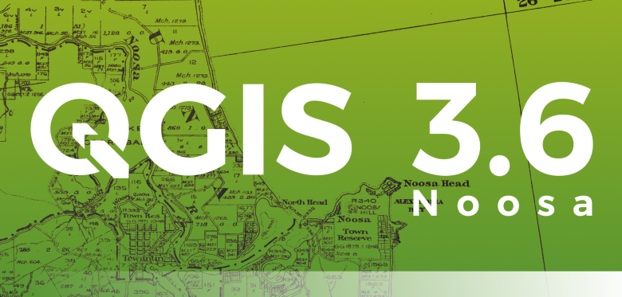
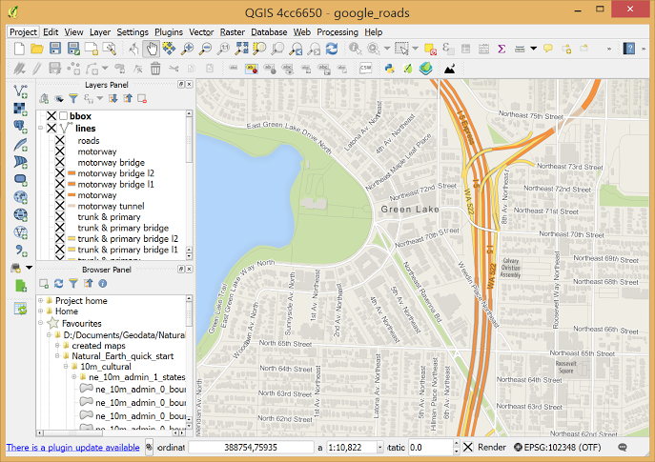
Highlighting Suitable Areas

Slide 5




Mapping Competitors Locations

Slide 6

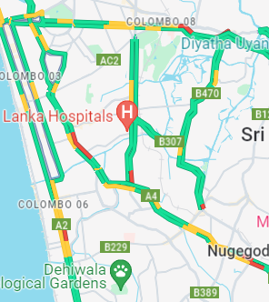


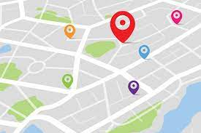
Highlighting Suitable Areas
Proposal Details Database
Keells Location Intelligence System (KLIS)
Mapping Competitors Locations
Keells Outlet Mapping

Slide 7
THANK YOU

